Slide 1
Tropical Cyclone Heat Potential Changes
between 1993 and 2012
Joshua Coupe

Slide 2
Outline
TCHP and it’s role in tropical cyclogenesis
Methods/Data -- what I set out to accomplish
How SST and TCHP changed from 1993 to 2012
Atlantic Hurricane Basin
West Pacific Hurricane Basin
TCHP’s implied relationship with:
Number of named storms
Accumulated Cyclone Energy
Conclusion
Limitations of my interpretations

Slide 3
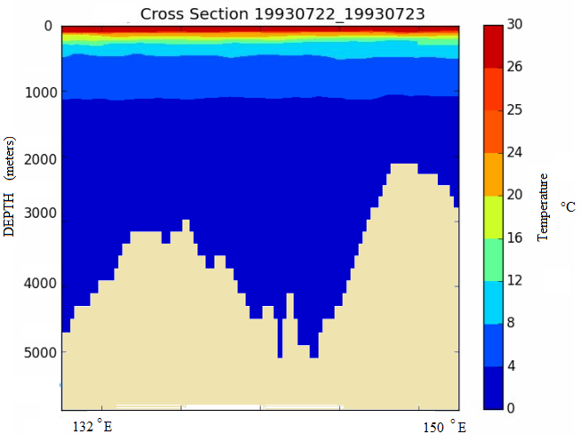
What is TCHP?
→ Tropical Cyclone Heat Potential (KJ/cm²)
→ representation of the oceanic energy available
for tropical cyclogenesis
→ essentially the maximum bound on latent heat flux

Slide 4
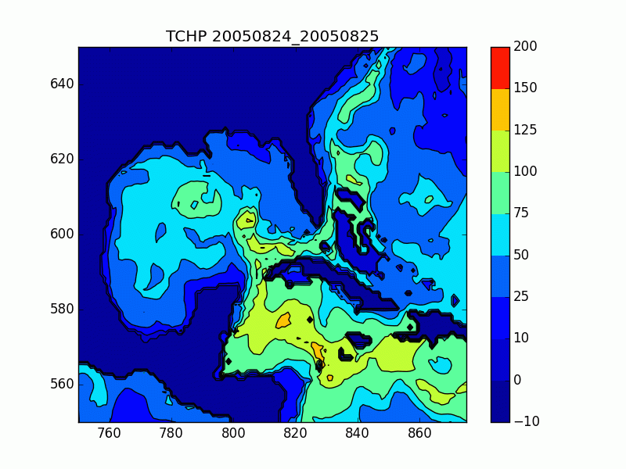
Anecdotal Evidence -- Hurricane Katrina 2005
→ Developed into a monster
Category 5 hurricane
→ Upwelling of cold water
to the surface present
KJ/cm²
→ Hurricane Katrina
was influenced by the
Loop Current

Slide 5
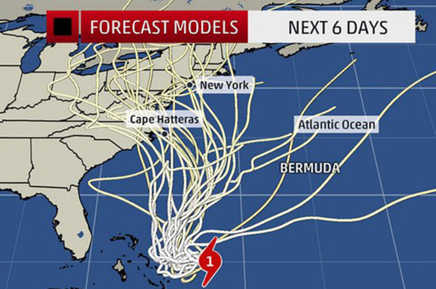
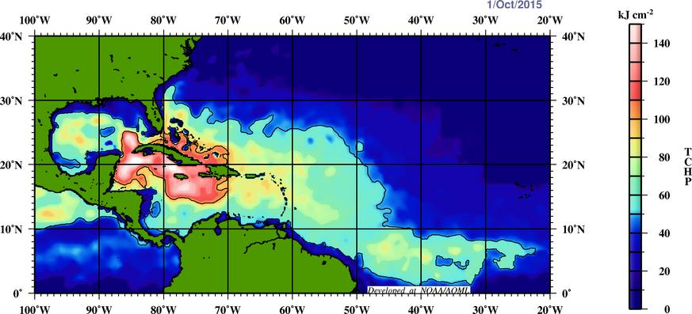
Anecdotal Evidence -- Hurricane Joaquin 2015
-Joaquin passed over very high
TCHP over the Bahamas
→ winds of 155 mph
→ 931 mb lowest pressure
Large reservoir of latent heat,
combined with low vertical
wind shear meant ...
Tropical Cyclone Heat Potential of the north Atlantic basin on October 1st, 2015 as per Remote Sensing Systems and NOAA/AOML

Slide 6
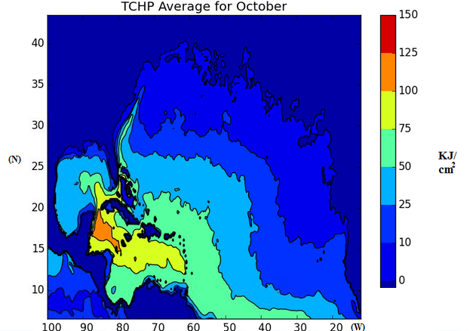
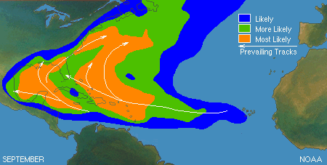
Areas of highest TCHP coincide with areas of tropical cyclogenesis
September

Slide 7
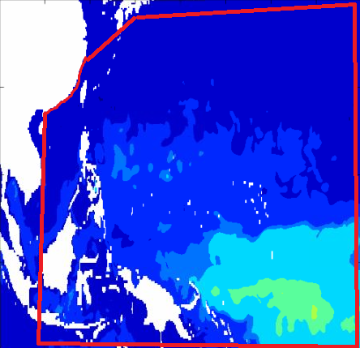
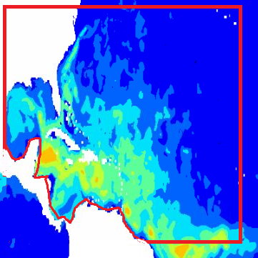
II. Methods
→ using GLORYS2V1, a global ocean model reanalysis with a ¼ ° resolution as well as temperature profiles
calculated TCHP for both the North Atlantic and northwest Pacific basins
Atlantic: 20°W to 98°W, 5°N to 40°N
Pacific: 115°E and 180°E, 5°N and 40°N

Slide 8
II. Methods/Data
→ using GLORYS2V1, a global ocean model reanalysis with a ¼ ° resolution as well as temperature profiles
calculated TCHP for both the North Atlantic and northwest Pacific basins
Atlantic: 20°W to 98°W, 5°N to 40°N
Pacific: 115°E and 180°E, 5°N and 40°N
Timing: Hurricane Season for Atlantic Basin (June to November)
Global calculation took too much time and memory
stuck with two of most active basins

Slide 9
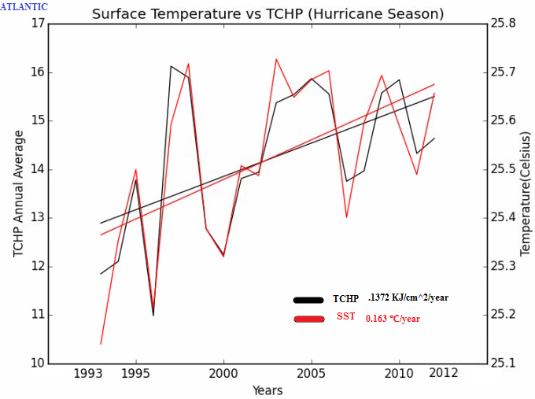
Atlantic Basin
(just energy above 26 degrees C)
137.2 J / cm² / year added
→ Distributed across the
area of the entire Atlantic
basin, this amounts to
2.34 x 10¹⁶KJ per year
KJ/cm²

Slide 10
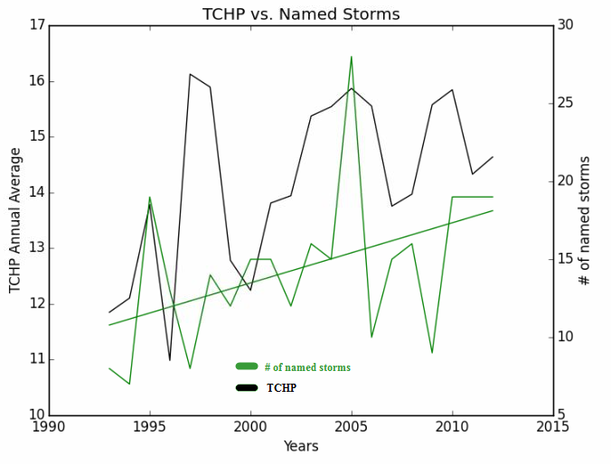
Atlantic Basin
→ 0.39 more named storms each
year over the 20 years where TCHP
increased by 0.1372 J / cm² / year
2005 shifts trend upward
→ Another metric may be
more useful ...

Slide 11
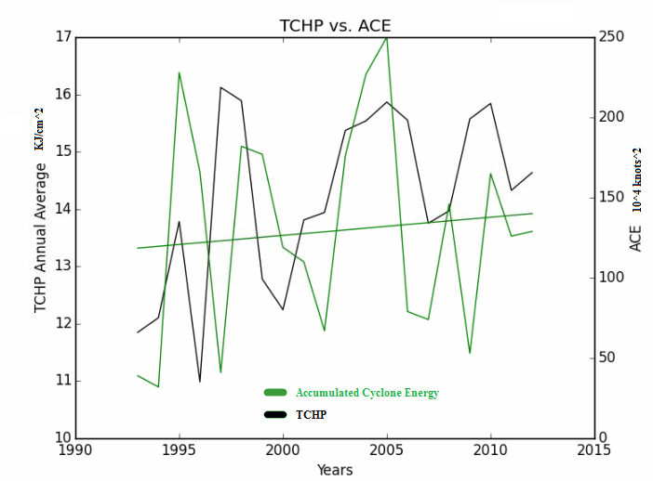
Atlantic Basin
Accumulated Cyclone Energy (ACE)
is the sum of squares of maximum
winds in a hurricane over the duration
of the hurricane in 10⁴ knots²
→ upward trend of 1.323 x 10⁴ knots²
per year
a lot of variability to consider
not particularly robust
only 20 years

Slide 12
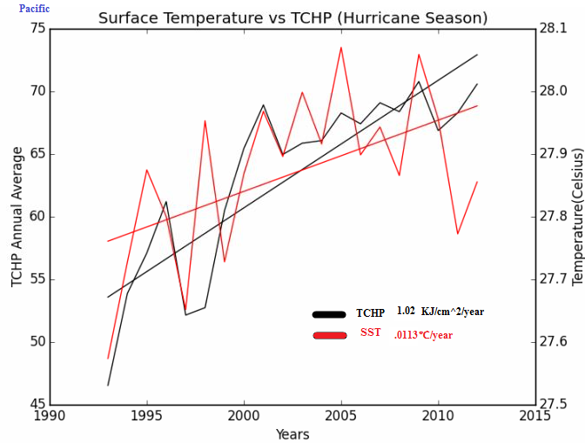
Pacific Basin
1020 J / cm² / year added
→ Distributed across the
area of the entire Pacific
basin, this amounts to
3.24 x 10¹⁷ KJ each year

Slide 13
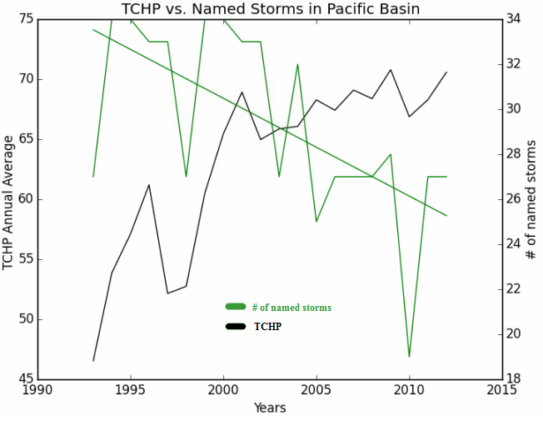
Pacific Basin
→ 0.435 less typhoons each
year over the 20 years where TCHP
increased by 1.02 KJ/cm² per year.
downward trend in stark
contrast to Atlantic basin

Slide 14
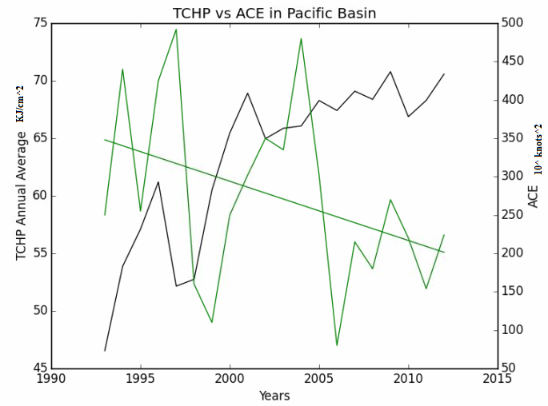
Pacific Basin
Accumulated Cyclone Energy (ACE)
is the sum of squares of maximum
winds in a hurricane over the duration
of the hurricane in 10⁴ knots²
→ downward trend of 7.72x10⁴ kts⁴ per year
much clearer trend than the Atlantic

Slide 15
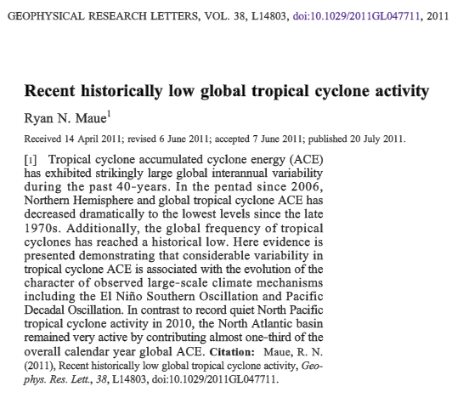
Long term climate cycles
→ negative PDO
-higher La Nina frequency since 2006
-negative impact on W. Pacific typhoons
→ Atlantic has more Cape Verde hurricanes
-last longer, more energetic
Atmospheric signal gets in the way
of the oceanic energy signal

Slide 16
Conclusions
→ The upper bound of energy available for tropical cyclogenesis has risen over the past 20 years in both the Atlantic and Pacific basins
→Under ideal atmospheric conditions, tropical cyclogenesis should be more intense (as the ocean is on board)
-> however, the atmospheric component gets in the way
->an investigation of the oceanic-atmospheric interaction would paint a better picture of how tropical cyclogenesis is changing with time

Slide 17
References
Baik, J.-J. and J.-S. Paek (1998): A climatology of sea surface temperature and the maximum intensity of western North Pacific tropical cyclones.J. Meteor. Soc. Japan, 76, 129–137
Briegel, L. M. and W. M. Frank (1997): Large-scale influences of tropical cyclogenesis in the western North Pacific. Mon. Wea. Rev., 125, 1397–1413
Emanuel, K. (2005) Increasing destructiveness of tropical cyclones over the past 30 years. Nature, 436, 686-688.
Fei-Pun, I., Lin, I., Lo, M.,(2013): Recent increase in high tropical cyclone heat potential area in the Western North Pacific Ocean, Geophysical Research Letters, 4680-4684
Ferry, N., Parent, L., Barnier, B., et al(2013).GLORYS2V1 Global Ocean Reanalysis of the Altimetric Era (1993 to 2009) at Mesoscale., Mercator Ocean - Quarterly Newsletter.
Fu, B., Li, T., Peng, M., (2007): Analysis of Tropical Cyclogenesis in the Western North Pacific for 2000 and 2001, Weather and Forecasting, 22, 763-780
Hurricane Joaquin Advisory Archive (2015), NOAA National Hurricane Center. http://www.nhc.noaa.gov/archive/2015/refresh/JOAQUIN+shtml/120925.shtml?
Jaimes, B. and Shay, L.,, 2009: Mixed Layer Cooling in Mesoscale Oceanic Eddies during Hurricanes Katrina and Rita. Mon. Wea. Rev.,137, 4188–4207.
Joint Typhoon Warning Center (2014). 2014 Annual Tropical Cyclone Report: Western Pacific (PDF)(Report). United States Navy, United States Air Force.
Kozar, M. and Misra, V. (2015), Statistical Prediction of Integrated Kinetic Energy in North Atlantic Tropical Cyclones. Center for Ocean-Atmospheric Prediction Studies, Florida State University.

Slide 18
More references...
Kossin, J. P., S. J. Camargo, and M. Sitkowski (2010), Climate modulation of North Atlantic hurricane tracks, J. Clim., 23, 3057–3076,
Landsea, Chris., (2015): How many tropical cyclones have there been each year in the Atlantic basin?, NOAA Hurricane Research Division Atlantic Oceanographic & Meteorological Laboratory.
Maue, R., (2011), Recent historically low global tropical cyclone activity. Geophysical Research Letters, 38, LI4803.
Wada, A. and Usui, N (2007)., Importance of Tropical Cyclone Heat Potential for Tropical Cyclone Intensity and Intensification in the Western North Pacific, Journal of Oceanography, 63, 427-447
Wada A. and Chan, JCL (2008) Relationship between typhoon activity and upper ocean heat content. Geophys Res Lett 35:L17603.
Wada, A., (2015), Verification of tropical cyclone heat potential for tropical cyclone intensity forecasting in the Western North Pacific, Journal of Oceanography, 71, 373-387
Landsea, Chris., (2015): How many tropical cyclones have there been each year in the Atlantic basin?, NOAA Hurricane Research Division Atlantic Oceanographic & Meteorological Laboratory.

Slide 19
