Slide 1
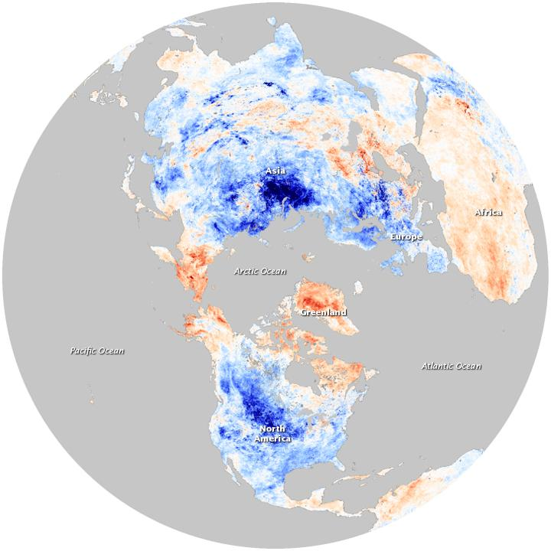
Eurasian Snow Cover Influence on North American Winter Temperatures
Joshua Coupe

Slide 2
Outline
Introduction: the case for a link
Data/Methods
Results
SON Eurasian snow cover correlated with DJF North American temperatures
SON Eurasian snow cover correlated with DJF 500mb geopotential heights
Top 5 snowiest Eurasian SON correlated with DJF 500mb geopotential heights
Predictability for 2017

Slide 3
Introduction
Arctic Oscillation (AO) is the dominant mode of winter variability in the NH
associated with the North Atlantic Oscillation (NAO), which influences jet stream over North Atlantic, and most importantly, temperatures.
+AO = strong polar vortex; -AO = weak polar vortex
Mechanisms hypothesized to modulate the AO:
North Atlantic SSTs (Rodwell et al 1999; Robertson et al 2000; Hoerling et al 2001)
Equatorial Indian Ocean SSTs ( Hurrell et al 2004; Selten et al 2004)
Greenhouse gases (Fyfe et al 1999; Osborn 2004; Miller et al 2006)
Eurasian snow cover
Objective: find evidence of Eurasian snow cover inducing AO / NAO circulations

Slide 4
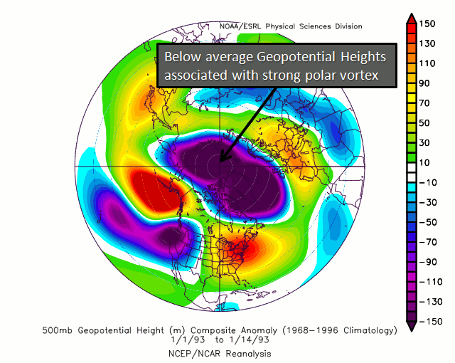
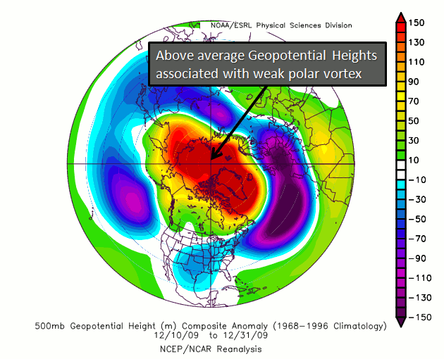
+AO -AO

Slide 5
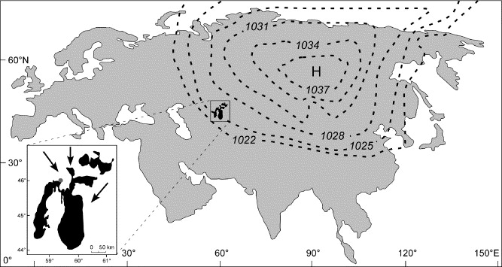
Why Eurasian Snow Cover?
Snow negatively affects a region’s energy balance mostly through albedo changes
Polar region circulations are responsible for much of our climate
Higher than normal snow cover assists in creating very strong high pressure over Siberia
High pressure can spill over into eastern North America and displace the stratospheric polar vortex ...
It can also act to modify an air mass

Slide 6
Why Eurasian Snow Cover?
Displacement of polar vortex involves a coupling of troposphere and stratosphere in winter.
Eurasian snow cover acts as a heat sink, expands Siberian high which influences high latitude Rossby waves formed when air passes over high topography
Rossby waves propagate both up and down
Coupling between stratosphere and troposphere causes waves to weaken stratospheric polar vortex
Weakened stratospheric polar vortex propagates . downward to troposphere, beginning of -AO

Slide 7
Data
NH SCE CDR v01r01, a comprehensive northern hemisphere snow cover extent dataset from November 1966 to November 2016 in millions of square kilometers. (Rutgers University Global Snow Lab)
GHCN_CAMS Gridded 2m Temperature, global monthly mean 2m temperature reanlysis at ½ degree resolution for January 1948 to current.
GHCN_CAMS Gridded 500mb Geopotential Heights, global monthly mean 500mb geopotential heights reanalysis at 2.5 degree resolution for January 1948 to November 2016.
Time used: SON 1972 through DJF 2016 ( 43 years )

Slide 8
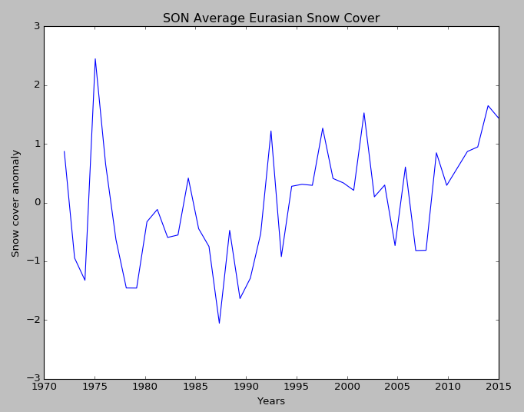
1972-2015 SON Eurasian Snow Cover Anomaly
Notes:
Mostly below normal between 1976 and 1992, trending upwards in recent years.

Slide 9
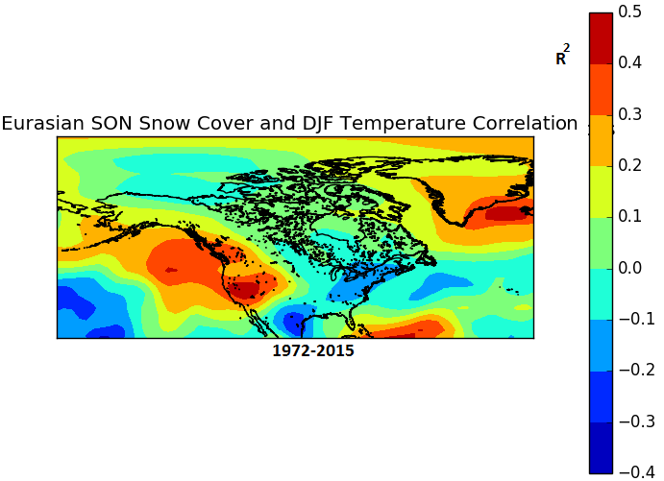
Results: SON Eurasian snow cover v. DJF temperature
-Low correlations on a point for
point basis.
-AO / -NAO signals: cold eastern US, warm SE Greenland
PNA signals: warm west US, cool eastern US.
??? signals: cold Texas, warm Caribbean.

Slide 10
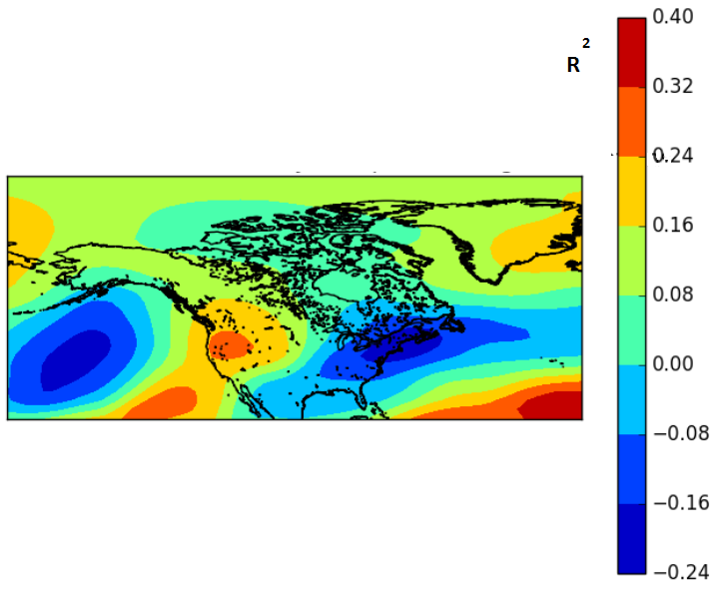
Results: SON Eurasian snow cover v. DJF 500mb GH
-Low correlations on a point for
point basis.
Eurasian SON Snow Cover and 500mb Geopotential Height Correlation
(Saito et al., 2001) found a -.71 correlation between SON Eurasian snow cover and DJF 500mb GH across entire NH
PNA pattern: deep Aleutian low, ridging in west, trough in east.
-AO / -NAO: higher geopotential heights at pole, lower geopotential heights in mid-latitudes (with exception of ridge over western US.)

Slide 11
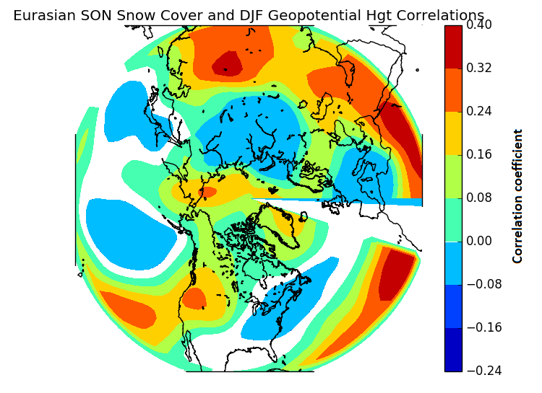
Results: SON Eurasian snow cover v. DJF 500mb GH
-Low correlations on a point for
point basis.
Eurasian SON Snow Cover and 500mb Geopotential Height Correlation
(Saito et al., 2001) found a -.71 correlation between SON Eurasian snow cover and DJF 500mb GH across entire NH
PNA pattern: deep Aleutian low, ridging in west, trough in east.
-AO / -NAO: higher geopotential heights at pole, lower geopotential heights in mid-latitudes (with exception of ridge over western US.)

Slide 12
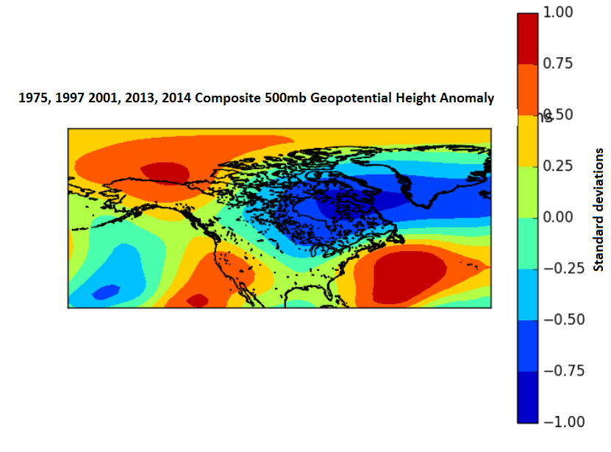
Amplifying the signal: Top 5 snowiest Eurasian autumns
1975, 1997, 2001, 2013, 2014 DJF geopotential heights averaged together with hopes to get a stronger signal with the most extreme cases.
Very strong SE ridge
High geopotential heights in Arctic, but low height anomalies not as far south.
Ridging on west coast still present, PNA possibly still in play.

Slide 13
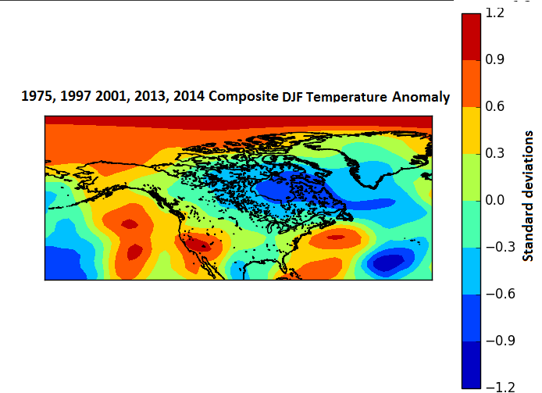
Amplifying the signal: Top 5 snowiest Eurasian autumns
1975, 1997, 2001, 2013, 2014 temperature anomalies averaged together with hopes to get a stronger signal with the most extreme cases.
VERY warm Arctic (>1 SDs)
Warm/cold lines up with geopotential heights fairly well.
Very warm North Pacific

Slide 14
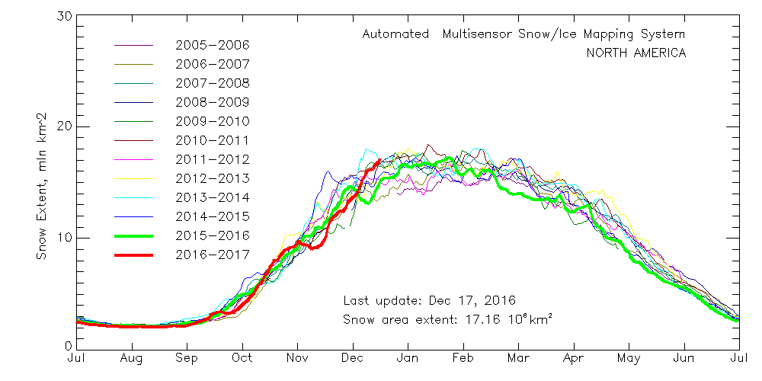
Prediction for 2017
Average snow area extent for SON: 13.066 million km^2 ( +2.09 SD)

Slide 15
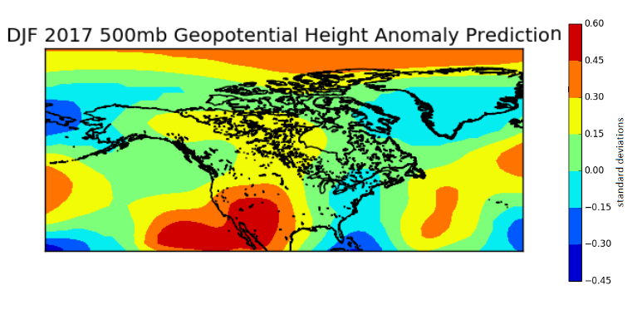
Prediction for 2017
A little late for winter predictions, but here goes nothing.

Slide 16
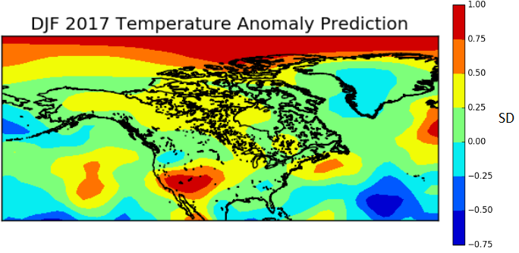
Prediction for 2017
A little late for winter predictions, but here goes nothing.

Slide 17
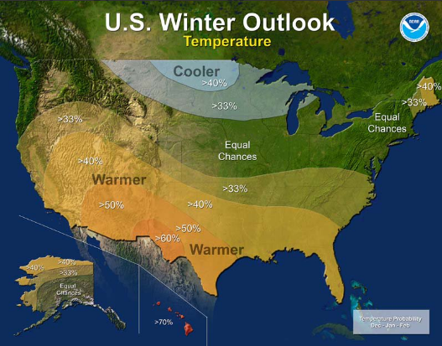
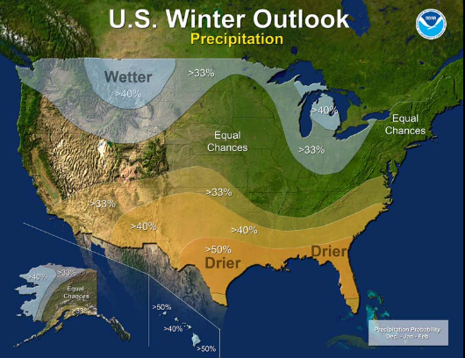
Prediction for D2016 - JF 2017

Slide 18
Prediction for D2016 - JF 2017

Slide 19
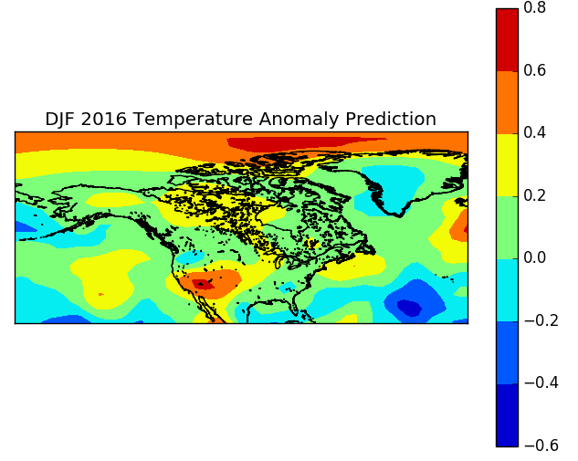
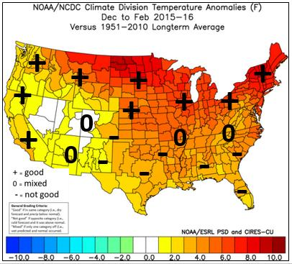
Last year’s prediction?
Interesting parallels, but warm ENSO phase dominated temperatures.
Average snow area extent for SON: 12.313 million km^2

Slide 20
Conclusion
Set out to prove that above average Eurasian snow cover caused an atmospheric response that looked like -AO / -NAO
Discovered a response that was as much +PNA as -AO
Anthropogenic climate change may also be complicating things, but I ran out of time to analyze that further.

Slide 21
References
Allen, R. J., Zender, C. S, 2011: Forcing of the Arctic Oscillation by Eurasian Snow Cover. Journal of Climate., Vol. 24, 6258-6539.
Ambaum, M., Hoskins, B., Stephenson, D. Arctic Oscillation or North Atlantic Oscillation, 2001. Journal of Climate, Vol 14. 3495-3507.
Cohen, J., and M. Barlow, 2005: The NAO, the AO, and global warming: How closely related? J. Climate, 18, 4498–4513.
Cohen, J., and D. Entekhabi, 1999: Eurasian snow cover variability and Northern Hemisphere climate predictability. Geophys. Res. Lett., 26, 345–348.
Itoh, H. Reconsideration of the True versus Apparent Arctic Oscillation, 2008. Journal of Climate. Vol 21. 2047 - 2062.
Kalnay et al.,The NCEP/NCAR 40-year reanalysis project, Bull. Amer. Meteor. Soc., 77, 437-470, 1996.
Kuroda, Y. and Kodera, K. Role of Planetary Waves in the Stratosphere-troposphere Coupled Variability in the Northern Hemisphere Winter, 1999. Geophysical Research Letters, Vol. 26, No.15, 2375-2378.

Slide 22
Robinson, David A., Estilow, Thomas W., and NOAA CDR Program (2012):NOAA Climate Date Record (CDR) of Northern Hemisphere (NH) Snow Cover Extent (SCE), Version 1.. NOAA National Climatic Data Center. doi:10.7289/V5N014G9.
Saito, K., and J. Cohen, 2003: The potential role of snow cover in forcing interannual variability of the major Northern Hemisphere mode. Geophysical Research Letters, 30, 1302.
Saito, K., and J. Cohen., and D. Entekhabi, 2001: Evolution of atmospheric response to early-season Eurasian snow cover anomalies. Monthly Weather Review., 129, 2746-2760
Shindell, D. T., R. L. Miller, G. A. Schmidt, and L. Pandolfo, 1999: Simulation of recent northern winter climate trends by greenhouse-gas forcing. Nature, 399, 452–455
Wagner, J. A., 1973: The influence of average snow depth on monthly mean temperature anomaly. Mon. Wea. Rev., 101, 624-626
Wallace, J. M. and Gutzler, D. S., 1981. Teleconnections in the Geopotential Height Field During the Northern Hemisphere Winter. Monthly Weather Review, Vol 109. 784-
Wu, Q., Hu, H., and Zhang, L. Observed Influences of Autumn-Early Winter Eurasian Snow Cover Anomalies on the Hemispheric PNA-like Variability in Winter, 2011. Journal of Climate, Vol. 24. 2017-2032.

