Slide 1
The Reconstruction of SDHN4 Wind Data Using A Multiple Linear Regression
Joshua Coupe

Slide 2
Background
Hurricane Sandy underwent an extratropical transition on 10/29/12 as it approached NJ.
→ expansion of windfield, no real weakening led to extremely impactful storm
→ scientific instruments destroyed, as SDHN4 (Sandy Hook) met station stopped recording data on 10/29/12 shortly after 12Z.
→ Windspeed data unavailable through April 2015.
The purpose of this analysis is to use all available data sources to make a best approximation of that missing data.

Slide 3
Data
To reconstruct SDHN4 winds, the following wind data is used:
Buoy 44065 observations
Buoy 44025 observations
Point data, hourly, mostly continuous with the exception of minor gaps for maintenance or minor storms taking out sensors briefly.
RU-WRF 3km model data at SDHN4, 44065, and 44025
Run operationally for offshore wind energy development
Run nearly continuously from April 2012 through present
Validated using criteria in Dvorak et al. (2012)
3km spatial resolution, 1h temporal resolution 35N-42.5N, 70W-79W grid.

Slide 4
RU-WRF Verification
Replication of verification in Glenn and Dunk, 2013 done here.
Adapted from the National Renewable Energy Laboratory (NREL) procedures.
Failure to meet one of the metrics means the model does not verify.
The standard deviation of the RU-WRF model winds must be similar to the standard deviation of the observed winds, therefore the percent-difference must be no greater than 10%.
The centered root mean square error between the observations and the model winds must be less than the standard deviation of the observed winds, where
centered root mean square error =
y is the model windspeed, y is the observed windspeed, ybar represents the mean of that variable, and n is the number of datapoints.

Slide 5
Table 1. Verification statistics for buoys/towers for 2012-2016.
2012-2016 | 44009 | 44025 | 44065 | 44017 | 44014 | CHLV2 | 44066 | BRND1H | BUZM3H | SJSN4H | SDHN4 | CMAN4
WRF SD (U,V) | 4.508, 5.152 | 4.952, 5.077 | 4.758, 4.878 | 5.252, 5.111 | 4.268, 5.637 | 5.193, 6.741 | 5.397, 5.204 | 4.795, 5.245 | 4.991, 4.975 | 3.048, 3.491 | 2.818, 3.059 | 4.434, 5.064
Obs SD (U,V) | 4.406, 5.426 | 5.045, 5.144 | 4.979, 5.043 | 5.479, 4.882 | 4.294, 5.838 | 5.059, 7.113 | 5.586, 5.347 | 4.822, 5.583 | 5.529, 5.967 | 4.497, 4.537 | 3.819, 3.341 | 3.164, 3.204
% diff (U,V) | 2.3%, 5.1% | 1.85%, 1.30% | 4.4%, 3.3% | 4.2%, 4.5% | 0.6%, 3.5% | 2.58%, 5.2% | 3.4%, 2.7% | 5.5%, 6.1% | 9.7%, 16.6% | 32.2%, 32% | 26.2%, 8.4% | 28.6%, 36.7%
CRMSE (U,V) | 2.287, 2.683 | 2.135, 2.347 | 2.328, 2.459 | 2.223, 2.340 | 2.285, 2.715 | 2.986, 3.305 | 2.699, 2.781 | 2.859, 2.894 | 2.661, 2.959 | 2.985, 2.564 | 2.201, 2.096 | 5.402, 5.878
# of points | 9598 | 22578 | 29172 | 19816 | 24153 | 26598 | 13418 | 18277 | 32616 | 30429 | 16063 | 31187
Height (m) | 5 | 5 | 5 | 5 | 5 | 43.3 | 5 | 19.3 | 24.8 | 20.4 | 5.5 | 9.7

Slide 6
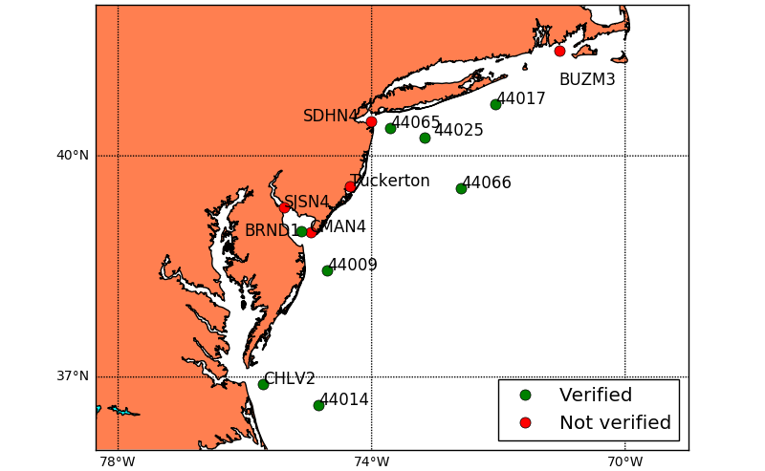
Conclusion:
RU-WRF at 3km was unable to fully characterize the 10m winds over certain land surfaces.

Slide 7
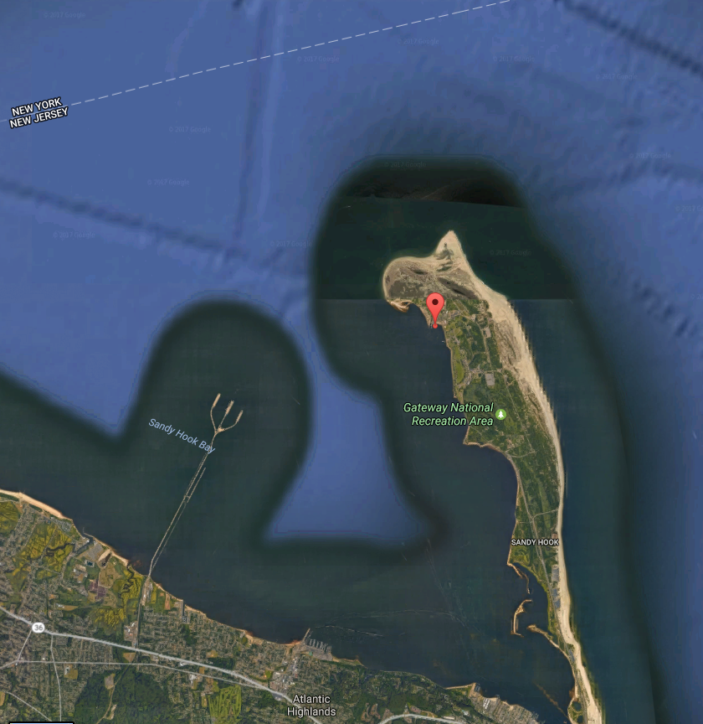
With the location of SDHN4, one would expect easterly and northerly winds to be compromised.
The centered root mean square error for easterly winds was 2.01 m/s while westerly winds was 2.50 m/s.
Greater error existed for westerly winds, but westerly winds were twice as common and likely to include wind gusts.
std. deviation of westerly winds= 3.49 m/s
std. deviation of easterly winds = 2.51 m/s.
Normalized, this comes to a CRMSE of 0.8 SD for U winds and 0.7 SD for V winds, a very small difference.
Ultimately, there was little correction that could be applied based on direction.
Notes:
Topographic effects of easterly winds masked by the more frequent fronts coming from the west

Slide 8
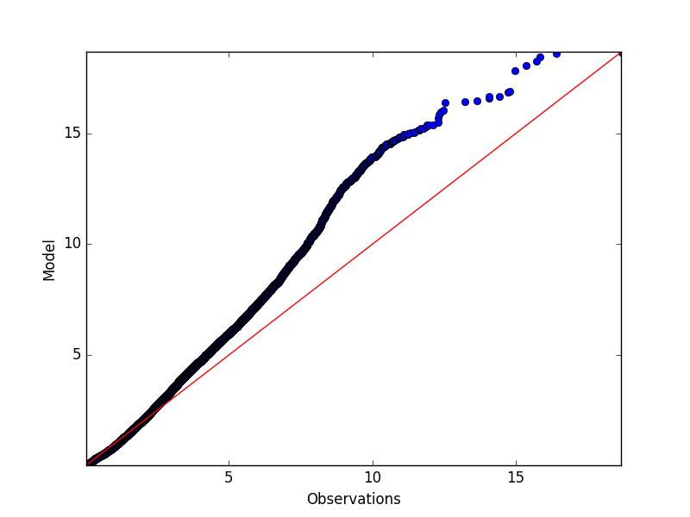
Other potential biases
At higher windspeeds, a high bias exists:
QQ plot of model vs observed windspeeds (m/s)
Notes:
Appropriate regression model would bring down high bias. QQ plot shows the distribution of windspeeds.

Slide 9
To construct a regression model, the observations from the buoys were used to train the regression model.
Sites closest to SDHN4 were used to best represent the immediate area.
RU-WRF data was used to alleviate differences due to land sfc, distance.
Correlations were removed between different variables used to construct model.

Slide 10
Three different regression models based on availability of data:
1. All available data:
Regression for u = 0.3198*WRF_sdnh4 + 0.1029*buoy_40025 + -0.0492*WRF_44025 + 0.0322*WRF_44065 + 0.5034*buoy_44065 r2 = 0.8594
Regression for v = 0.3003*WRF_sdhn4 + -0.0771*buoy_44025 + -0.0412*WRF_44025 + 0.0757*WRF_44065 + 0.4902*buoy_44065 r2 = 0.7731
2. Only model data available:
U regression = 0.3775*WRF_44025 + 0.0064*WRF_44065 + 0.5537*WRF_sdhn4 r2 = 0.7403
V regression = 0.2334*WRF_44025 + 0.0249*WRF_44065 + 0.5698*WRF_sdhn4 r2 = 0.6718
3. Only observations available:
U regression = 0.1746*buoy_44025 + 0.5646*buoy_44065 r2 = 0.742
V regression = -0.0631*buoy_44025 + 0.6508*buoy_44065 r2 = 0.6377
Notes:
To construct a continuous dataset, needed 3 different regressions

Slide 11
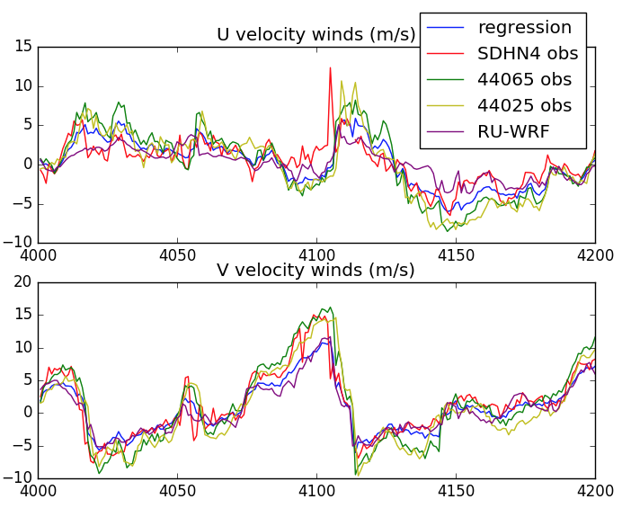
Results
Figure 4. U and V velocity winds from 09/14/2012 at 16 UTC through 09/23/2012 at 00 UTC.
In general, the regression is bounded between all data, smoothing out drastic increases.

Slide 12
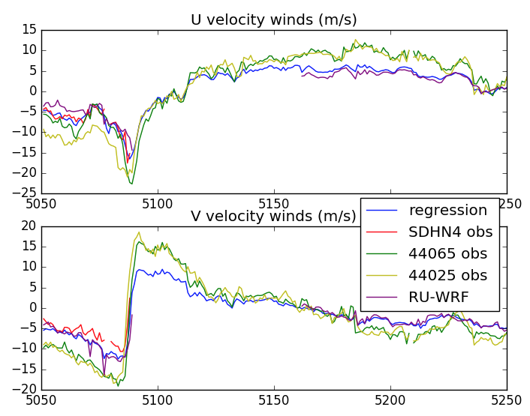
Results
Figure 5. U and V velocity winds from 10/28/2012 at 10 UTC through 11/05/2012 at 18 UTC.

Slide 13
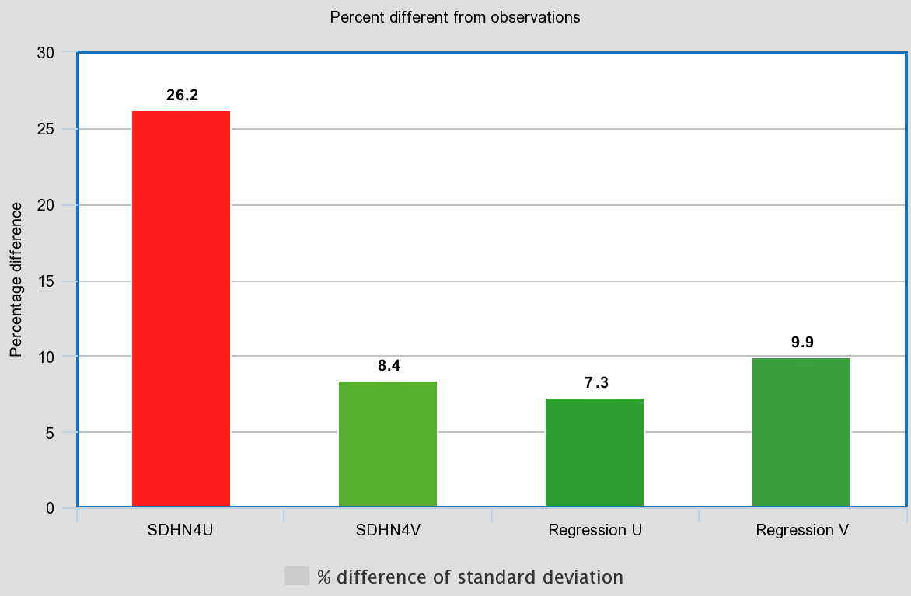
Performance of regression model (compared with WRF)
Reduction of U,V CRMSE from (2.201, 2.096) → (1.611, 1.770) with regression model.
SDHN4 standard deviation was (3.819 m/s, 3.341 m/s) for the observations and (3.537 m/s, 3.009 m/s) for the regression model- a deviation of (7.3%, 9.9%), indicating a remarkable improvement for the U winds, at the expense of the V winds.

Slide 14
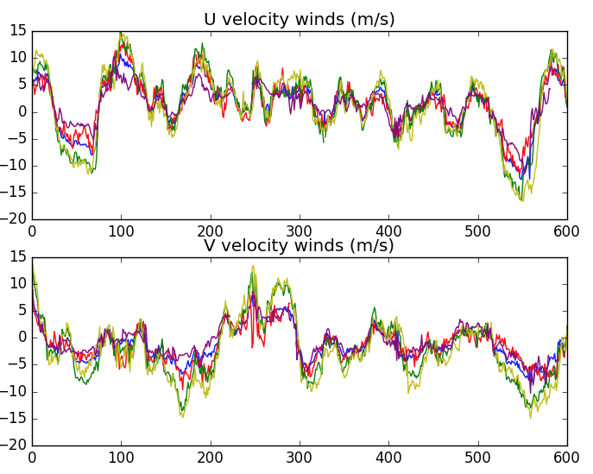
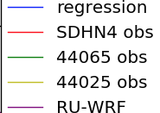
Comparison with untrained data
To demonstrate the accuracy of the regression model, data not used to train the regression is tested. The data ranges from January 1st, 2017 at 00UTC through January 25th at 18 UTC.
SD = standard deviation
SDHN4 SD(u,v) = 4.51, 3.20 m/s
WRF SD(u,v) = 3.39, 2.84 m/s
Regression(u,v) = 4.57, 3.09 m/s
% difference between SD WRF and observations = 33%, 12.7%
% difference between SD of regression and observations = 1.3%, 3.6%

Slide 15
Comparison with untrained data
To demonstrate the accuracy of the regression model, data not used to train the regression is tested. The data ranges from January 1st, 2017 at 00UTC through January 25th at 18 UTC.
CRMSE = centered root mean square error
CRMSE(U,V) between WRF and observations = 2.42, 2.02 m/s
CRMSE (U,V) between regression and observations = 1.53, 1.58 m/s

Slide 16
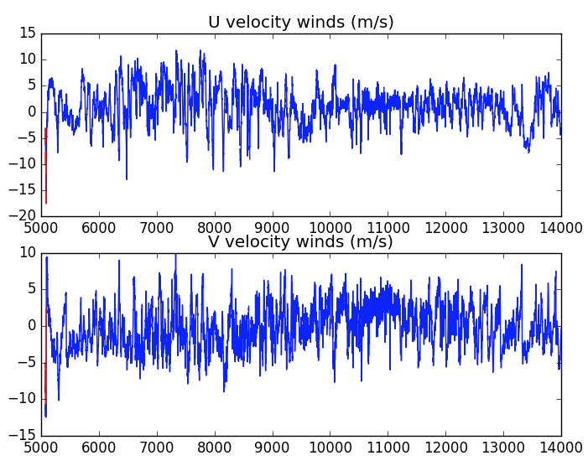
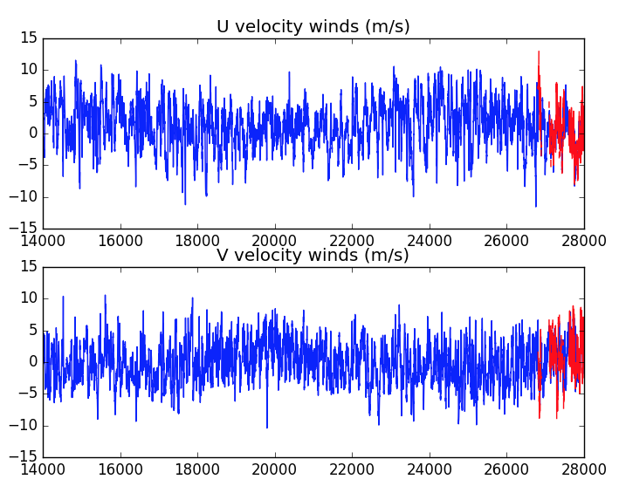
Conclusion
Given the regression model’s performance for the untrained 2017 data, can conclude this is a sufficient reconstruction.
Expansion of this work: correct for timing of fronts using pressure data at different buoys by understanding shortcomings of RU-WRF during frontal passages.

Slide 17
References
Allen, R. J., and A. T. De Gaetano, 2001: Estimating missing daily temperature extremes using an optimized regression approach. Int. J. Climatol., 21, 1305–1319.
Galarrneau, T. J., Davis, C. A., Shapiro, M. A., 2012. Intensification of Hurricane Sandy (2012) through Extratropical Warm Core Seclusion. Monthly Weather Review. Vol. 141, 4296-4321.
Glenn, S. and Dunk, R., 2013. An Advanced Atmospheric/Ocean Assessment Program Designed to Reduce the Risks Associated with Offshore Wind Energy Development Defined by the NJ Energy Master Plan and the NJ Offshore Wind Energy Economic Development Act.
Kemp, W. P. D., D. G. Burnell, D. O. Everson, and A. J. Thomson, 1983: Estimating missing daily maximum and minimum temperatures. J. Climate Appl. Meteor., 22, 1587–1593.
Tardivo, G. and Berti, A. (2017). A Dynamic Method for Gap Filling in Daily Temperature Datasets. Journal of Applied Meteorology and Climatology.
Weiss, S.J., Pyle M. E., Janjic,. Z., Bright, D., Kain, J., DiMego, G., 2008: The Operational High Resolution Window WRF Model Runs at NCEP: Advantages of multiple model runs for severe convective weather forecasting. Preprints, 24th Conf. on Severe Local Storms, Savannah, GA, Amer. Meteor. Soc., P10.8.

